Slide 1

Software Measurement and Analysis
Team
Assignment 9
-------=====-------
K15T2 - Team 2
-------=====-------

Slide 2




Contents
Metrics
Defect Life Cycle
Defect Detection Arrival Rate by Severity Metric
Cumulative Defects By Status
Related Document

Slide 3
Metrics
Intended Audience
Functional Test Manager
Project Manager
Change Control Board (CCB)
Functional test team members

Slide 4
Metrics
Goal / Question / Metric

Slide 5
Contents
Metrics
Defect Life Cycle
Defect Detection Arrival Rate by Severity Metric
Cumulative Defects By Status
Related Document

Slide 6
Metrics
Defect Life Cycle

Slide 7
Contents
Metrics
Defect Life Cycle
Defect Detection Arrival Rate by Severity Metric
Cumulative Defects By Status
Related Document

Slide 8
Defect Detection Arrival Rate by Severity Metric
Metric Requirement Statement
To evaluate the detection arrival rate by severity of defect in this release in order to deliver our software product with required quality and insure that all known defects are corrected before shipment.

Slide 9
Defect Detection Arrival Rate by Severity Metric
Standardized Definitions
Severity Levels: The importance of the problem, as defined by the customer (typically based on the problem’s impact on the user). There are four levels of Severity:
1 – Critical
2 – High
3 – Medium
4 – Low

Slide 10
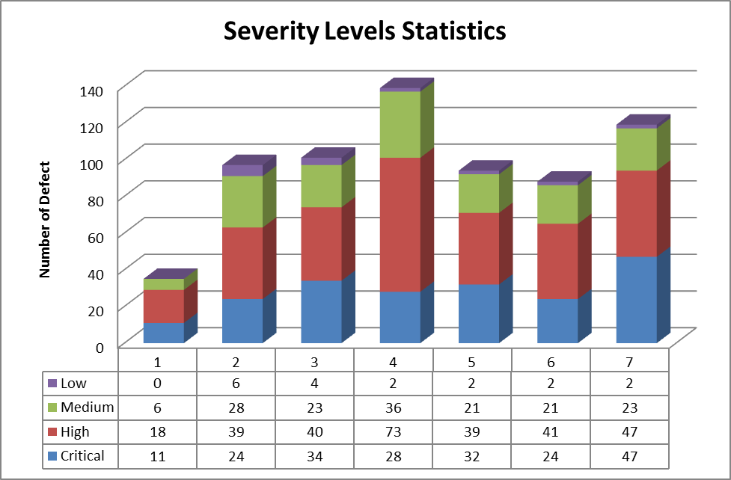
Defect Detection Arrival Rate by Severity Metric

Slide 11
Defect Detection Arrival Rate by Severity Metric
Look at the chart, we can see that:
All week has defects and the number of defect quickly increase starting from week 2
Week 4 has the highest number of defect with 139 defects and it has signs of decrease in two weeks later.
Critical level defect and High level defect are rise almost all week and highest in week 7.
General, the number of defect is still high after 7 weeks of work and this is a bad sign for this project.

Slide 12
Contents
Metrics
Defect Life Cycle
Defect Detection Arrival Rate by Severity Metric
Cumulative Defects By Status
Related Document

Slide 13
Cumulative Defects By Status
Metric Requirements Statement
To evaluate the number by status of the known defects in this release in order to deliver our software product with required quality and ensure that all know defects are corrected before shipment.

Slide 14
Cumulative Defects By Status
Standardized Definitions
Status | Status Meaning
Open | New, not yet assigned
Reopen | A defect that was previously Closed, Pending or Rejected has been Reopened. Typically this means that the Customer or QA has been able to reproduce the defect.
Rejected | From the evaluation it has been determined that this is either not a defect or it can't/won't be resolved.
Further Analysis | From the evaluation it has been determined that additional analysis is required
Pending | Additional information has been requested from the person who submitted the defect
Approved | The defect has been approved for resolution
Assigned | The defect has been assigned to a software engineer who will work on the defect
Resolved | The software engineer responsible for fixing the defect believes that the defect is fixed. Typically this means that the updated product passes all unit and integration tests.
Tested | The defect is considered resolved by the QA team
Closed | The updated product is available for release. Sometimes the original defect submitter is responsible for closing defects, but often this isn't possible.

Slide 15
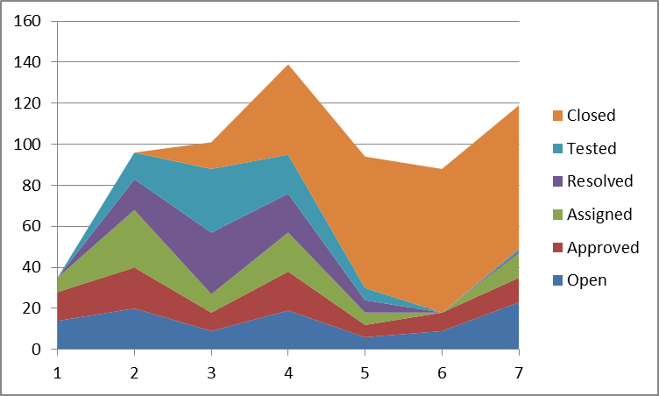
Cumulative Defects By Status
Assumption and comment

Slide 16
Cumulative Defects By Status
Assumption from chart:
Defect collection was performed before beginning time in Viking_Product_Defect_Data.xls file.
There was defects had been opened before was closed in Viking_Product_Defect_Data.xls file.
The beginning time of Viking_Product_Defect_Data.xls file will be assume at the start time of testing phase.
The testing phase lasted for 15 weeks, so the data only show the status of defects at half way of testing phase.

Slide 17
Cumulative Defects By Status
Comment:
The project team worked quite well, there have defects has been opened before starting the testing phase , for 7 weeks testing team worked and has 261 defect closed, the defects arising until the seventh week is 100. So the project team has a fix and close defects from the previous stage with good performance.

Slide 18
Recommend
Based on the defect data, we list as follow to recommend ensuring that quality is not an accident for the Viking project:
Have defined process to control quality, especially defect control.
Collect defect frequency and record them to easy access and control.
Defect life cycle must be conduct at the early of project, there for we can easily fix and reduce the project cost.
Defect life cycle must be must be performed seriously and accurately to ensure no defect was omitted, no found defect was ignored.

Slide 19
Thanks
for your listening!

